Slide 1
Overview & Benefit Options
Presented by Kevin Wenndt
Senior Retirement Benefits Officer

Slide 2
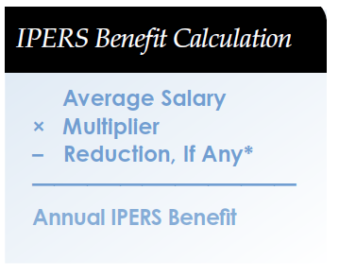
What is IPERS?
$32 billion trust fund – the largest public retirement system in Iowa
A defined benefit program
Lifetime retirement benefits are paid based on a formula, not on the amount of contributions
Formula factors: age, years of service, highest average salary
*Early-retirement reduction applies only to the benefits of Regular members who retire before normal retirement age.
2
Notes:
The lifetime benefit you receive is predictable & stable because it is calculated using a formula; As your years of service increase, your IPERS benefits grow. Benefits aren’t tied to the performance of the stock market, so you don’t have to worry about riding out the bumps in the market.

Slide 3
What is IPERS?
Members include
Public schools, cities, counties, state government, state universities, public hospitals, emergency workers, and more
355,000 members
2,000 covered employers
117,000 retirees
Nearly $2 billion paid in benefits annually
3
Notes:
The lifetime benefit you receive is predictable & stable because it is calculated using a formula; As your years of service increase, your IPERS benefits grow. Benefits aren’t tied to the performance of the stock market, so you don’t have to worry about riding out the bumps in the market.

Slide 4
DB vs. DC: What’s the Difference?
IPERS
(Defined Benefit Plan)
401(k), 403(b), etc.
(Defined Contribution Plan)
Guaranteed Benefit | YES. Monthly benefit is guaranteed for life. | NO. Benefit fluctuates with market performance.
Investment Risk | Pooled investments. IPERS takes on all the risk. | YOU take on all the risk.
Withdrawals & Loans | NOT AVAILABLE | TYPICALLY AVAILABLE
Vesting | 100% in your contributions. | 100% in your contributions.
Portability | YES | YES
Death Benefits | YES | YES
Disability Benefits | YES. IPERS provides disability benefits depending on certain qualifications. | NO. Defined contribution plans do not usually provide disability benefits.
Fees & Expenses | INCLUDED | TYPICALLY HIGH
4
Notes:
Guaranteed Benefit
YES. Your benefit is guaranteed for life, no matter how long you live, and no matter how the investments perform.
STABLE. Your benefit amount is determined by a formula based on your years of service and your average salary. Once determined, it will not change.
IT IS NOT UNPREDICTABLE: Your benefit is not based on your contributions, any employer contributions, and any investment earnings or losses (minus any withdrawals or loans received.)
Investment Risk
IPERS takes on all the investment risk. The amount of your benefit is not affected by fluctuations in the investment market.
YOU take on all the investment risk. You are responsible for deciding how your money is invested and for monitoring its performance.
Withdrawals & Loans
NOT AVAILABLE. Your IPERS funds are not available to withdraw or borrow against. Only terminated members may withdraw their money. This is an important difference between IPERS and defined contribution plans.
TYPICALLY AVAILABLE. Most defined contribution plans allow for withdrawals and loans. However, withdrawals and loans will significantly reduce future benefits that will be needed in retirement.
Vesting
100% in your contributions. After 4 years of service or when you reach age 55 while making contributions employment, you become vested in a portion of the employer contributions made on your behalf. Effective 7/1/12, vesting requirements change to 7 years of service, or when you reach age 65 while in IPERS-covered employment.
100% in your contributions. Vesting in your employer’s contributions varies by the employer (plan sponsor). For example, some plans allow a gradually increasing percentage of vesting for several years before you reach 100 percent.
Portability
YES . If you leave public employment, you may roll over the value of your account to another (qualified) retirement plan, take a refund, or, depending on the amount, leave it with IPERS until a later date.
YES. Your vested funds may be rolled over to another retirement (qualified) plan.
Death Benefits
YES. IPERS provides pre- and post-retirement death benefits.
YES. Your account balance will transfer to your beneficiary(ies) when you die. Your beneficiary(ies) decides how payment is made.
Disability Benefits
YES. IPERS provides disability benefits depending on certain qualifications.
NO. Defined contribution plans do not usually provide disability benefits.
Fees & Expenses
INCLUDED. All fees and expenses are paid by the IPERS Trust Fund and do not affect the amount of your benefit payment.
TYPICALLY HIGH. All fees and expenses are distributed across accounts or taken directly from individual balances.

Slide 5
How Does it Work?
Lifetime retirement benefits,
disability benefits,
death benefits, and refunds are paid out.
Contributions from
active members
and employers are paid in.
The IPERS Trust Fund
The IPERS Trust Fund must be used for the exclusive benefit of members and their beneficiaries.
Only vested members are eligible for a monthly benefit of any type.
Non-vested members are eligible for a refund of their contributions + interest.
5
Notes:
Both you & your employer contribute to IPERS & IPERS invests the contributions and holds the investment income in a Trust Fund for the exclusive purpose of paying benefits to members & their beneficiaries. The money employees contribute today is pooled & invested so it can grow and pay for their own future benefits.

Slide 6
What is Vesting?
Regular Member vested status is obtained after:
28 quarters (7 years) of reported wages or
When wages are reported in the same month age 65 or older is attained
Special Service vested status is obtained after:
16 quarters (4 years) of reported wages or
When wages are reported in the same calendar year age 55 or older is attained.
6
Notes:
This vesting change effective 7-1-2012. If vested June 30, 2012 under previous vesting rule, remained vested (at least 4 years of service or Age 55 or older contributing to IPERS)

Slide 7
Vesting
Entitles the member to:
Monthly retirement or disability benefit
A portion of employer’s investment if refund is taken (years of service/30)
Service Purchase at retirement (if vested by years of service, not age alone)
7
Notes:
Members under age 55 must be vested to receive a monthly benefit payment under the disability provisions.
A vested member who takes a refund will receive a portion of the employer’s investment based on the number of years they have contributed. For example, a member with 10 years of service will receive 1/3 of the employer’s investment.
In order to pay back an IPERS refund or make any other service purchase, a member must be vested.

Slide 8
Pre-retirement Death Benefits
Designated sole beneficiary of a vested member can elect lump-sum payment or lifetime monthly benefit.
If designated beneficiary is more than one individual or an entity, death benefit can only be paid in lump-sum payment.
If no beneficiary has been designated, lump-sum payment is made to the estate.
8

Slide 9
What’s My Part?
Contributions + interest
Contributions based on gross wages
IPERS can adjust the total contribution rate by no more than 1.0 percentage point up or down, following a yearly actuarial valuation.
9
Notes:
1.88% - 2019

Slide 10
2019 Contribution Rates
July 1 2019 – June 30 2020
6.29% from the member
9.44% from your employer
15.73%
6.61% from the member
9.91% from your employer
16.52%
9.51% from the member
9.51% from your employer
19.52%
10
Notes:
Total Regular Contribution Rate – 15.73%. IPERS sets Regular member contribution rates using an actuarial valuation, which is a snapshot of IPERS’ finances & that rate can increase or decrease by no more than 1%. Deductions for deferred compensation, TSA’s and other qualified tax deferred plans do not reduce the amount of wages reported to IPERS.

Slide 11
The Benefit Formula – Regular
IPERS Benefits are based on a formula:
*Early-retirement reduction applies only to the benefits of Regular members who retire before normal retirement age.

Slide 12
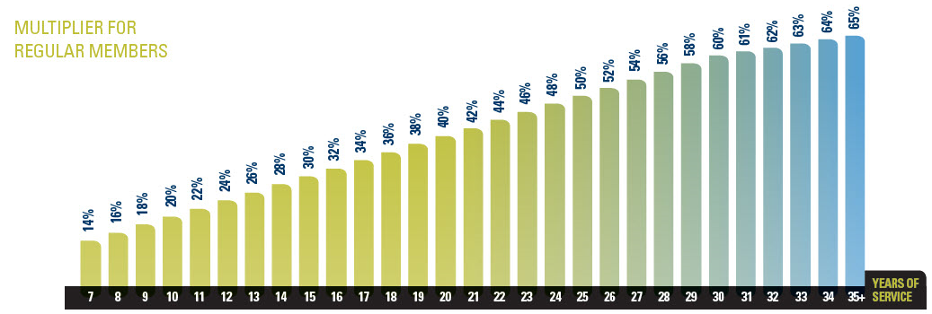
The Benefit Formula – Regular
The multiplier increases 2% per year for the first 30 years worked.
1% per year for years 31–35, for a maximum of 65% of final average salary.
Early retirement reduction applies if you retire before normal retirement.
12

Slide 13
Normal Retirement Age
Age 65
No minimum service requirement
Age 62 with 20 or more years of service
Rule of 62/20
Years of service + your age = 88 or greater
Rule of 88
13

Slide 14
Early Retirement Reduction
If you start receiving benefits before reaching a normal retirement, benefit reductions will apply.
Reduce 3% a year for portion of service through 06/30/12
From nearest normal retirement eligibility (rule of 88; rule of 62/20; age 65)
As of July 1, 2012
Reduce 6% a year thereafter
From age 65
14
Notes:
Request pension estimate prior to making final decision to retire, the value of an additional six more months could be significant.

Slide 15
Maximizing Years of Service
Free credit
Leaves of absence
Granted prior to July 1998
Requires verification from employer
Active military duty
Entered military as an IPERS-covered employee and returned to IPERS employment within one year of discharge
Submission of DD214 form required
15
Notes:
Documentation required from employer

Slide 16
Service Purchase Types
Nonqualified service (air time)
Refunded IPERS service (buy-back)
IPERS employment not previously covered
Other public system(s) (if not eligible to draw pension from the other system)
Active duty military/LOA time not eligible for free credit
IPERS buy-up credit conversion
5-year limit
16
Notes:
You can buy back the time, not the wages, you took as a refund from previous IPERS covered employment.
Non-covered time includes employment with wages of less than $300 per quarter prior to July 1992 and substitute teaching time.
Other public employment includes employment in another state, in Iowa (TIAA-CREF for example), federal government for which you will not receive a benefit.
Private sector includes any employment with wages paid into social security and doesn’t fall into the other public category.
The cost for service purchase is based on the highest calendar year of wages, the increase in benefits and how soon unreduced benefits will be paid if a purchase is made.
Must complete service purchase application, which can be mailed & is available on IPERS website.

Slide 17
Making a Service Purchase
Purchasing takes place at retirement.
Request a service purchase cost estimate to help you plan for a purchase at retirement.
Save money in a separate retirement account that can eventually be rolled over to IPERS to make your purchase.
You are never obligated to make a purchase.
17

Slide 18
Retirement Estimates
Request benefit estimates from IPERS before deciding on a retirement date.
Working a little longer could increase benefits significantly.
May be eligible to retire earlier!
18
Notes:
All retirement counselors answer our phone lines. We are there to assist you!

Slide 19
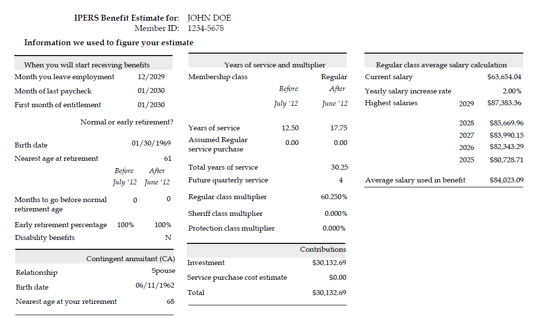
Sample Estimate
19

Slide 20
Important Facts
Working any time in a month makes you ineligible for benefits that month.
You can get a paycheck in the same month you start IPERS payments.
20

Slide 21
Getting Started
Must be age 55 or older
Unless vested and eligible for IPERS disability benefits
Must submit completed application
Benefits paid the last business day of month
Must terminate employment unless age 70
21

Slide 22
Benefit Payment Options
Six monthly payment options
Always lifetime to member
Different death benefit provisions
IMPORTANT: Your choice cannot be changed once benefit payments begin.
22

Slide 23
Option 1
Guarantees a lump sum payment at death.
Death benefit is designated in thousand dollar increments from the min. of $1000 to the highest thousandth of investment amount.
Multiple beneficiaries can be designated.
Beneficiary designations can be changed at any time.

Slide 24
Option Two
Option Three
Lump sum if any balance of investment remains
Highest monthly payment with no death benefit

Slide 25
Option Five
Death benefit only if member dies prior to receiving 120 payments.
Sole beneficiary to receive remainder on monthly basis.
Multiple beneficiaries eligible for Commuted Lump Sum payment only or the present value of any future benefits payments remaining.
Beneficiary designation can be changed at any time.

Slide 26
Definitions
Beneficiary
Can be one or more than one person
Can be changed at any point in retirement
Receives a lump sum
Contingent annuitant (CA)
Can only be one person
That person can NEVER be changed
Receives a monthly benefit

Slide 27
Option Four & Six
Contingent annuitant will receive a lifetime monthly benefit at death of member
Will receive 100%, 75%, 50% or 25% of member’s benefit payment
Percentage designated by member at retirement

Slide 28
Option Four & Six
Option 4 - If contingent annuitant precedes member in death, the monthly payment does not change.
Option 6 - If contingent annuitant dies first, member’s monthly payment will increase to option 2 benefit amount. If the member dies before recovering their investment, the balance will be paid to a beneficiary.

Slide 29
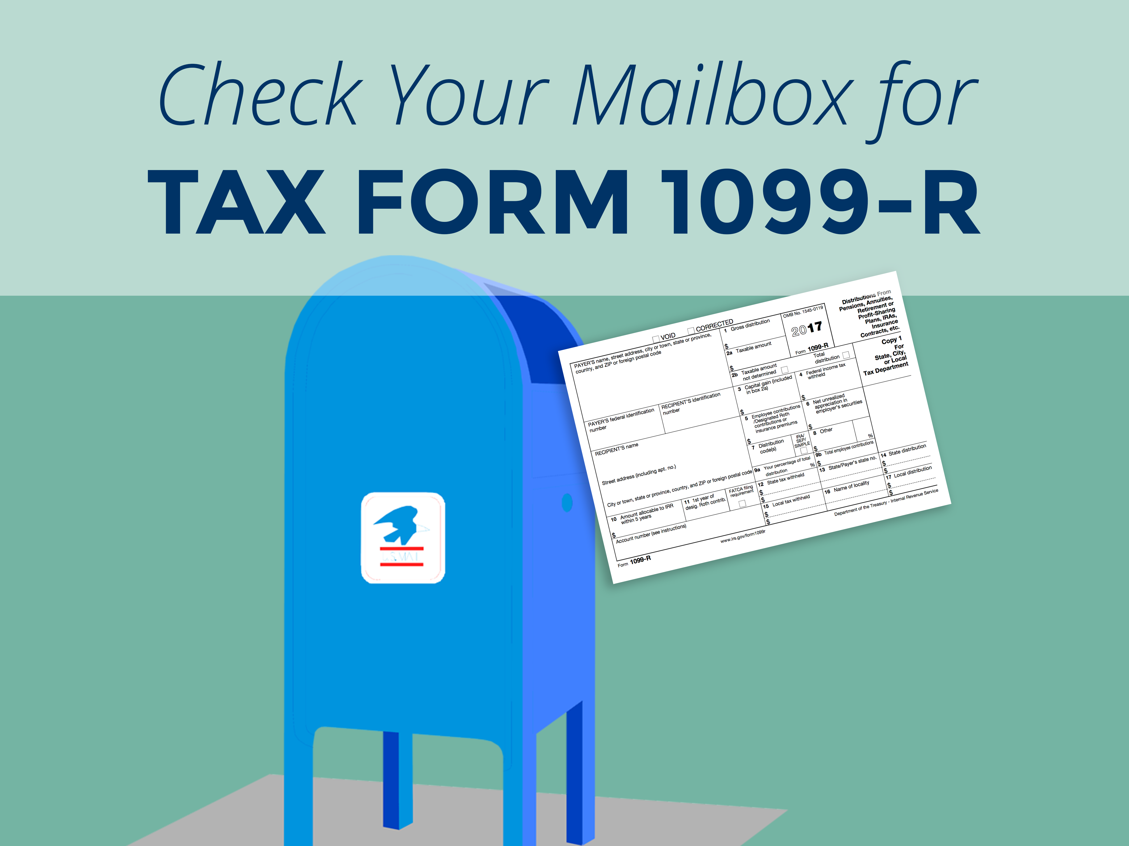
Taxes
Benefit payments are subject to federal and state income tax.
You can request that the tax can be withheld from your monthly benefit payment
IPERS will mail your 1099-R in January for tax purposes.
29
Notes:
For detailed tax information, contact the IRS for publication 575 or consult a tax advisor.

Slide 30
Returning to Work
To qualify for a Bona Fide Retirement, you must:
End all service with an IPERS-covered employer, including non-covered employment, with no written or verbal contract to return.
Not return to employment with an IPERS-covered employer before you have filed your IPERS benefit application.
IMPORTANT: There is a financial penalty for violating this requirement.
30

Slide 31
To Have a Bona Fide Retirement
File your IPERS retirement application.
End all service with covered employers, including non-covered service.
Stay out of all employment with a covered employer for one month.
Stay out of all employment in an IPERS-covered position for an additional three months.
31
Notes:
An IPERS covered employer is any employer with employees making contributions to IPERS. For example, State Universities and community colleges are considered to be IPERS employers since they have members who pay into TIAA-Cref or IPERS.
A covered position is one for which IPERS is taken out of the wages regardless of who fills the position. Most full and part time positions are covered positions. Temporary positions (less than six months) are not covered. A position is no longer considered temporary when wages have been reported for two consecutives quarters in which $1000 in wages have been paid. When this occurs, the member is then covered regardless of the amount of the wage paid in the next quarter as long as it’s within the next four quarters.

Slide 32
Bona Fide Retirement Update
Effective 7-1-2018
No bona fide retirement if a member:
Enters into a verbal or written arrangement to perform duties for their former employer(s) as an independent contractor prior to or during their first month of entitlement; or
Performs any duties for their former employer(s) as an independent contractor prior to receiving four months of retirement benefits.
32

Slide 33
Re-employment Guidelines
Applies to IPERS-covered employment only
$30,000 earnings limit under age 65 (benefits reduced 50 cents for each dollar earned over the limit)
No earnings limit after age 65
Benefits recomputed upon termination
33

Slide 34
Re-employment Guidelines
Must have a bona fide retirement.
It’s your responsibility to contact IPERS if you are returning to an IPERS-covered position.
Know the Social Security earning limits. SLIP rules may be different.
Contact us about specific elected official rules/questions.
34
Notes:
Returning to Work Restrictions
Retirees under age 70 who return to work for an IPERS-covered employer have certain restrictions on employment. All IPERS retirees under age 70 must have a bona fide retirement that meets both of these conditions:
End all service with an IPERS-covered employer, regardless of whether the person’s position with that employer is covered by IPERS.
Not return to work with an IPERS-covered employer for one month or to IPERS-covered employment for three additional months.
People who retire from certain positions may have a shortened bona fide retirement period. See the Member Handbook for a list.
Wage Limits After Retirement
There are certain earning restrictions for IPERS retirees who return to IPERS-covered employment. They are:
Retirees age 55–65 cannot earn more than $30,000 a year or the annual Social Security wage limit, whichever is higher. These wage limits may change each year. The limit does not apply if the retiree is elected to public office.
If the retiree earns more than $30,000, monthly benefits from IPERS will be reduced.
Retirees who have reached age 65 do not face an earnings limit.
Benefit Adjustments After Reemployment
When a retiree retires again, he or she should contact IPERS. IPERS will recalculate the retiree’s benefits. Reemployment does not always increase a retiree’s monthly benefit, in which case, a lump-sum payment is made.
The bottom line is this: it’s OK to get rehired under IPERS-covered employment. IPERS retirees just be sure to verify that a bona fide retirement period has been met.

Slide 35
When to Contact IPERS
4–6 months from retirement to obtain application packet
At termination, if before age 55 for additional options
If a disability occurs
35

Slide 36
Visit IPERS’ Website
Notes:
Log In – you must first call IPERS to have your account unlocked if you have never accessed and created your account.

Slide 37
IPERS’ Microsite
37

Slide 38
Contact Us
More questions?
E-mail: info@ipers.org
Website: www.ipers.org
Toll-free: 800-622-3849
Monday – Friday
7:30 am to 5:00 pm
38

Slide 39
Thank-you for attending!
Kevin Wenndt
7401 Register Drive
Des Moines, Iowa 50321
Ph. 515-281-0036 or 1-800-622-3849
kevin.wenndt@ipers.org or info@ipers.org
www.ipers.org

